Slide 1
Language Evaluation
CMSC 330: Programming Languages

Slide 2


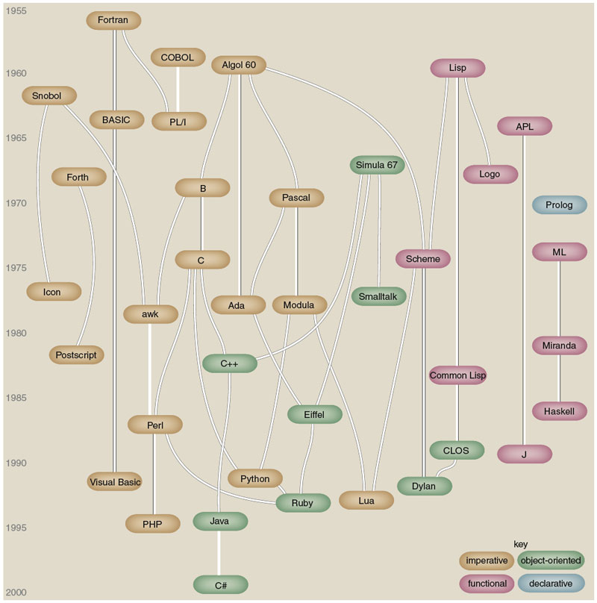


Slide 3
Programming Domains
1. Scientific
  Efficiency is paramount
  Floating-point computations, arrays, matrices
  Examples: Fortran, C++
2. Business
  Report generation, precise decimal arithmetic, high readability
  Examples: COBOL, Java

Slide 4
Programming Domains
3. AI
  Symbolic computation
  Flexible structures: linked lists, trees, graphs
  Code can be generated or updated while the program runs (dynamic execution)
  Examples: Python, Lisp, Prolog

Slide 5
Programming Domains
4. Web
  JavaScript, TypeScript, PHP, etc.
  Markup and Style: HTML, CSS
5. Systems
  Contrasted with application programming
  Write OS components, compiler, game engine, browser engine, etc
  Low-level hardware access
  Examples: C, C++, Rust, D, Carbon, etc

Slide 6
Language Evaluation Criteria
Controversial
From our textbook (Sebesta)
  Readability – how easily code can be read and understood
  Writability – how easily code can be written and expressed
  Reliability – how consistently the language behaves according to its official rules
  Cost – the overall expense of using the language, including training, development, and maintenance

Slide 7
Readability - Simplicity
A manageable set of features and constructs
Minimal feature multiplicity
  How many ways to increment a variable t in C++?
Minimal operator overloading
  Same operator + could do different things

Slide 8
Readability - Orthogonality
A language is orthogonal if its features are built upon a small, mutually independent set of primitive operations.
Primitive operations are the small, basic building blocks of a language’s semantics, such as create variables, assign values, function calls, integer addition, conditional branch.
Mutually independent: features work together consistently without special cases (fewer or no exceptional rules).
  E.g. Any data type can be passed to any function unless explicitly disallowed
  Non-orthogonal: a function cannot return an array

Slide 9
Readability – Data Types
Adequate predefined data types
Scalar: bool, char, short, int, double, etc.
Collection: array, vector, list, stack, queue, set, map, etc.

Slide 10
Readability - Syntax
Identifier forms: flexible composition
Keywords and methods of forming compound statements
  If { … } vs. if … endif
Form and meaning: self-descriptive constructs, meaningful keywords, whitespace
  static in C++ is bad since it has several unrelated meanings

Slide 11
Writability
Simplicity and Orthogonality
Support for abstraction
  Ability to define and use complex structures or operations in ways that allow details to be ignored
Expressiveness
  A set of relatively convenient ways of specifying operations
  Availability and richness of operators and built-in functions
    E.g. OCaml has no built-in integer power (** is for floats)

Slide 12
Reliability
Type checking
  Early versions of C compiler didn’t check parameter types
  Implicit conversions
Exception handling
  Deal with run-time errors
Aliasing pointers
  Multiple names referencing the same memory cell

Slide 13
Cost
Train programmers to use the language
Writing programs
Executing programs
Reliability
Maintenance

Slide 14
Language Design Trade-offs
Reliability vs. cost of execution
  Example: Java arrays perform bounds checking automatically
  Trade-off: extra runtime checks improve reliability but reduce performance
Readability vs. writability (expressiveness)
  Highly concise or flexible syntax can make code hard to read.
  Example: APL operators allow very compact, powerful expressions, but a single line can be nearly impossible to understand without experience.

Slide 15
Language Design Trade-offs
Writability (flexibility) vs. reliability
  Example: C++ pointers allow low-level memory manipulation:
  while (*p++) ++s; // concise but error-prone

